Slide 1
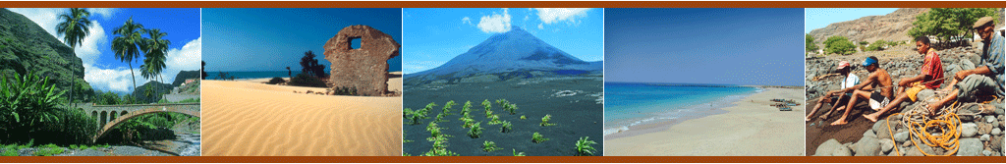
Transformation Agenda and State reform

Slide 2
CONTEXTUALIZATION OF THE COUNTRY
Cape Verde is now an emerging Country with new opportunities in terms of economic and social development:
Rapid growth of foreign direct investment that surpassed the weight of GDP development Publishes Help
Rapid growth of Tourism that exceeded the contributions of consignments of emigration
Positive performance in exports-tourism and fisheries.
Good governance Policy, economic, Political, Civil and economic Freedoms-considered to be more stable in Africa for the year 2011-12;
Population: 491,575 (INECV – census 2010)
Area: 4,033 sq km (1,557 sq miles)
Life expectancy: 73 years (men), 78 years (women) (UN)
GNI per capita: US $3,826 (World Bank, 2010)
Human Development Index (HDI): 0.568 (UN -2011)
Literacy Rate: 84,8% adults - 97% youngs (UN -2011)
Poverty reduction with inclusion: 27%
Unemployment rate: 13%
GDP Growth rate: 5,4% (2010) ; 3,6 % (2009) (World Bank)
Inflation rate: 4,5% (2011) ; 2,1 % (2010)

Slide 3
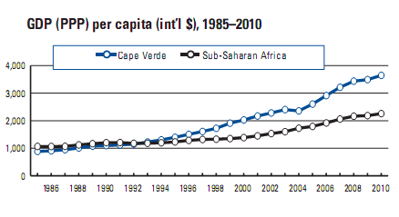
PER-CAPITA GROWTH EVOLUTION

Slide 4
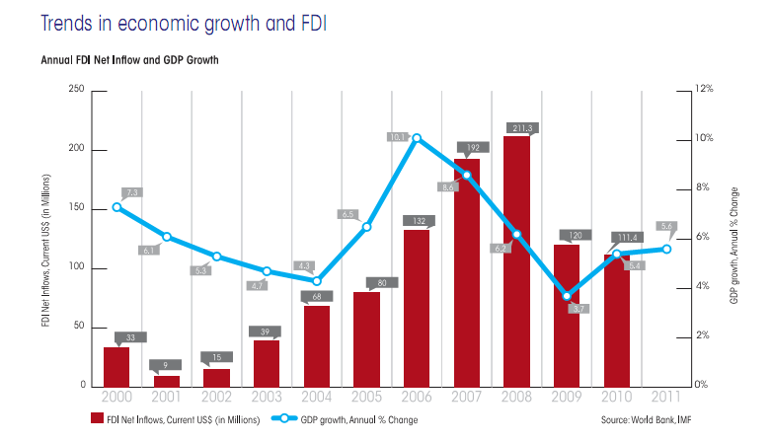
TRENDS IN ECONOMIC GROWTH AND FDI

Slide 5
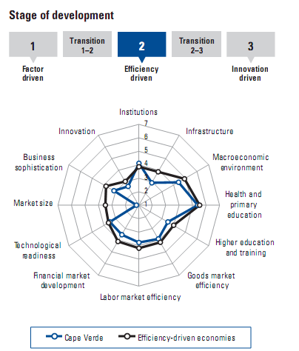

Slide 6
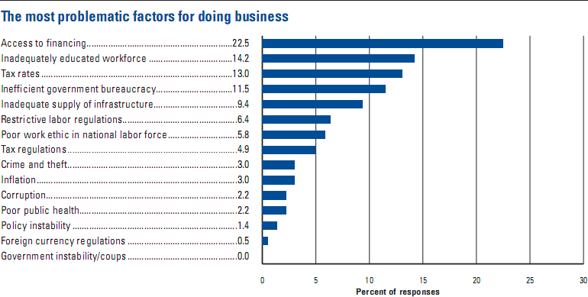
MAIN DEVELOPMENT CONSTRAINTS IDENTIFIED IN THE REPORT GLOBAL COMPETIVENESS
The most problematic factor for doing business

Slide 7

CAPE VERDE IS EXPECTED TO REACH THE MILLENNIUM DEVELOPMENT GOALS (MDGS) SET BY THE UN UNTIL 2015.
According to the an international survey conducted jointly by the African Development Bank (ADB), the United Nations Development Programme (UNDP) and United Nations Economic Commission for Africa, shows that Cape Verde "is one of the African countries to achieve the eight Millennium Development Goals".
Recently, Cape Verde stood, internationally, to the level of improvement in vaccination coverage.
Analysis of results in various international indicators, there is a balanced progression at all levels and political, economic and social indicators, which contribute to the development of the country. We continue to progress steadily in terms of human capital, institutional, economic and social, but still with strong constraints and challenges, within a framework of low middle-income country

Slide 8
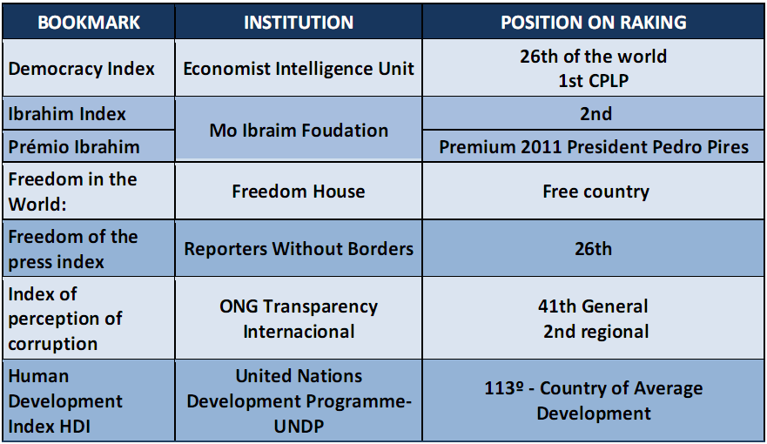
POLITICAL AND SOCIAL INDICATORS

Slide 9
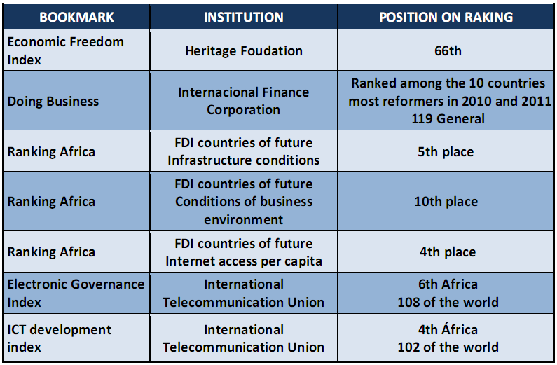
ECONOMIC INDICATORS

Slide 10
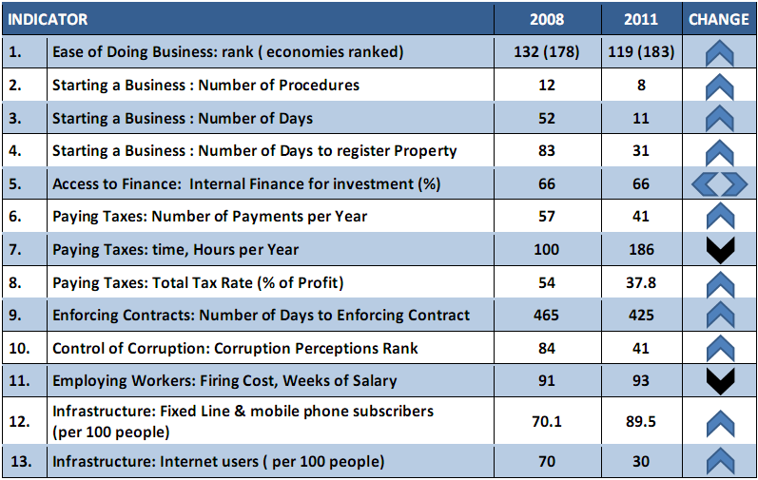
INDICATORS OF IMPROVEMENT OF BUSINESS
Cape Verde has showed improvements in tem out of the thirteen indicators analyzed. It has stayed the same in one indicator – Internal Finance Investment, and worsened in the two areas of paying taxes (time in hour per year) and firing costs.

Slide 11
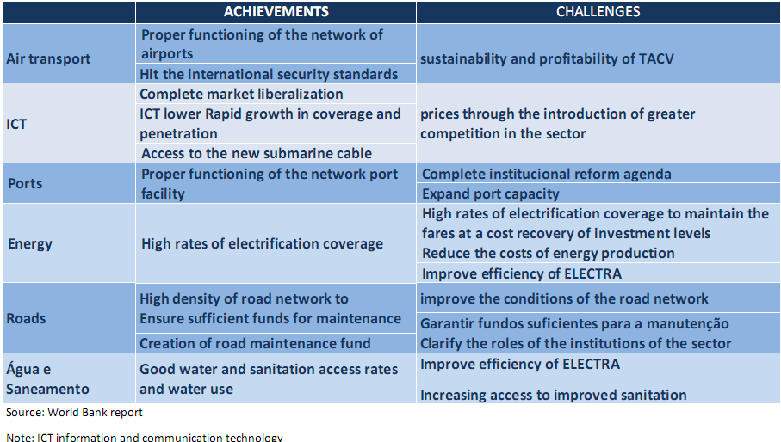
ACHIEVEMENTS AND CHALLENGES IN THE INFRASTRUCTURE SECTORS

Slide 12
THE NEW REALITIES REQUIRE:
Pass of aid management for creating and leveraging new opportunities
a solid vision, innovative policies and strategies, and a strategic approach to the management of sustainable development

Slide 13
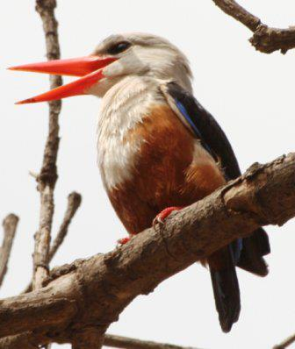
WHERE WE WANT TO GO
Transformation vision for Cape Verde
“ We want a country open to the world, with a strong and dynamic productive system, based on human capital enhancement, technological capacity building and on its culture. We want a society with solidarity, peace and social justice, that is democratic, open and tolerant.”

Slide 14
COMPARATIVE ADVANTAGES OF CAPE VERDE
Existing advantages
Location
Need to transition from a development pattern based on comparative advantages for a development paradigm focused on competitive advantages
Sea
Climate
COMPETITIVE ADVANTAGES
Strengthening the network
of external relations
Good governance
Human resources

Slide 15
Short and medium term
MEDIUM AND LONG TERM
At sea
TOURISM
Aid
By air
TRANSFERS
PRIVATE
LIGHT INDUSTRIAL
(FISHING)
SERVICES
OFFSHORE
Reforms
Economy
Open
Investments
Capabilities
Infrastructure
Investments
Capabilities
Infrastructure

Slide 16
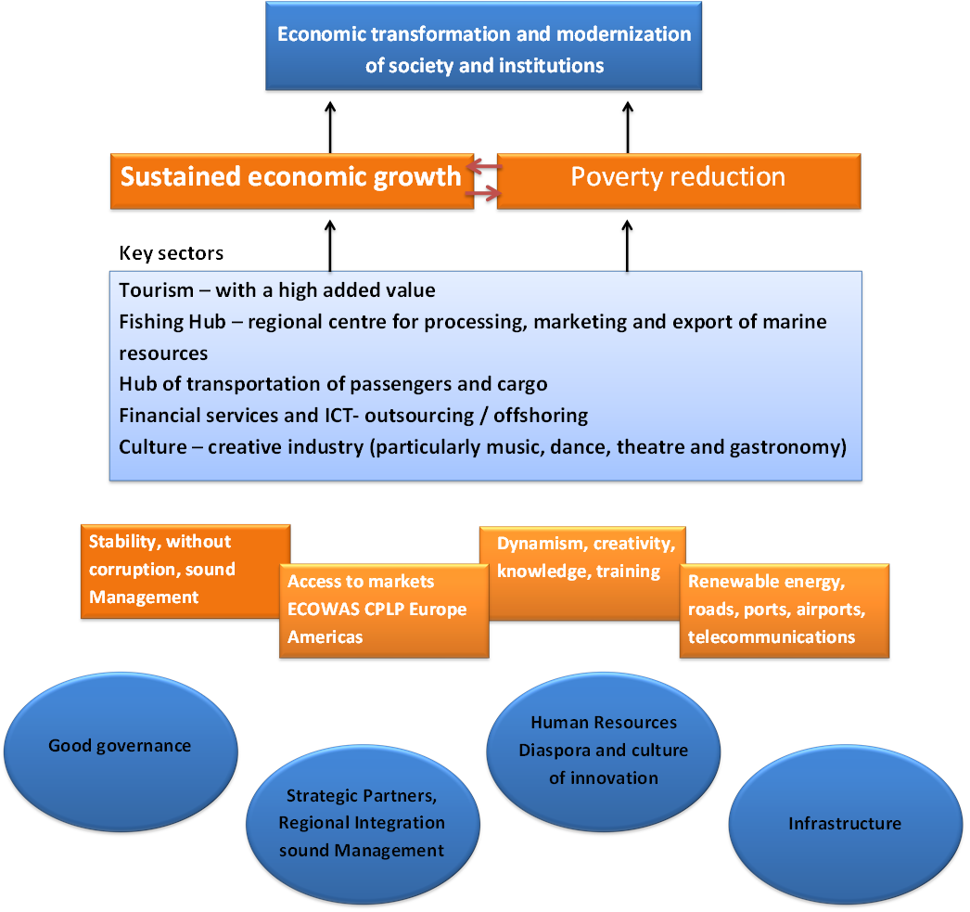
TRANSFORMATION AGENDA

Slide 17
PILLARS OF THE GOVERNMENT'S PROGRAMME 2011-2016, AXES OF TRANSFORMATION STRATEGY AND OBJECTIVES OF GOOD GOVERNANCE
The Government's programme
Build a dynamic economy, competitive, innovative and sustainable.
Promote private sector growth, investment and
Promoting social cohesion and improving access to basic services;
Empower HR and produce knowledge
Good Governance
Global Nation
Transformation strategy
Tourism with a high added value
Culture – creative economy
Modernization of agriculture.
Sea Cluster
ICT Cluster
International Business Center
Transhipment Hub
Consolidating democracy, deepen the freedoms, strengthen good governance
Consolidation of democracy, freedoms and broadening the area of citizen participation
modernization of Justice, service and faster and citizen development
Decentralization, land-use planning and balanced development
National Security in the service of democracy and development
Gender equity
Electronic governance
International Business Center
Transhipment Hub

Slide 18
PROGRESS OF REFORMS
1st stage-1975 – 1989 (welfare state – strong)
Construction of the new institutions of the new independent state with a focus on food security, universal access to health and education;
2nd stage – 1990 – 2000 (liberal state – minimun)
institutional reforms with a focus on the needs of political liberalization (democracy) and economic (market);
3rd stage – 2000 – 2011 (state regulator – needed)
institutional reforms in all walks of life and at all levels (macro and micro) – strengthening citizenship, modernization, transparency and competitiveness.

Slide 19
GOVERNMENT CHALLENGES
Development Challenges
Good Governance, State Reform, Democracy , citizenship
Enterpreneurial Capacity, competitiveness, growth
Development of human Capital, Improving educational system
Social development, reduce poverty, facilitate social choesion and solidarity
Basic and economic infrastructures
Action vectors for State reform
  Consolidation of Democracy
  Reforms in the justice and security sectors and modernization of Laws
  Rationalization of structures and adjusting institutions to the new realities
  Strengthen and improve State’s efficiency
  Improve regulatory and supervision capacity
  Innovations in governance - i-Gov

Slide 20
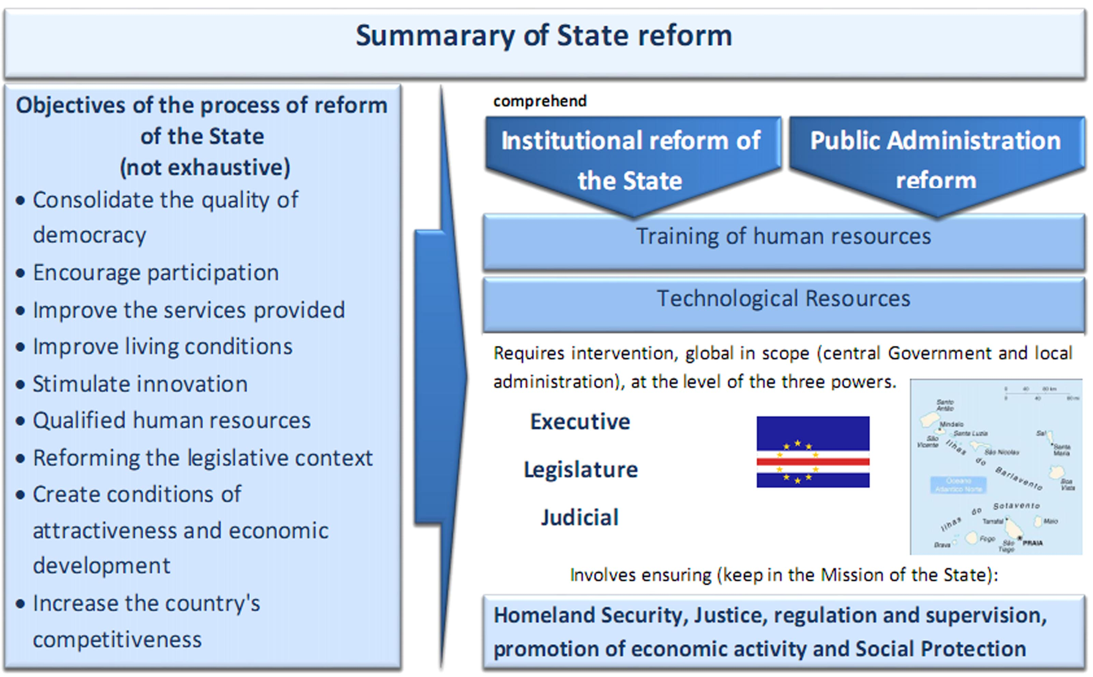
The reform of the State aims to leverage and meet the new challenges in the transformation process in Cape Verde.
Notes:
20

Slide 21
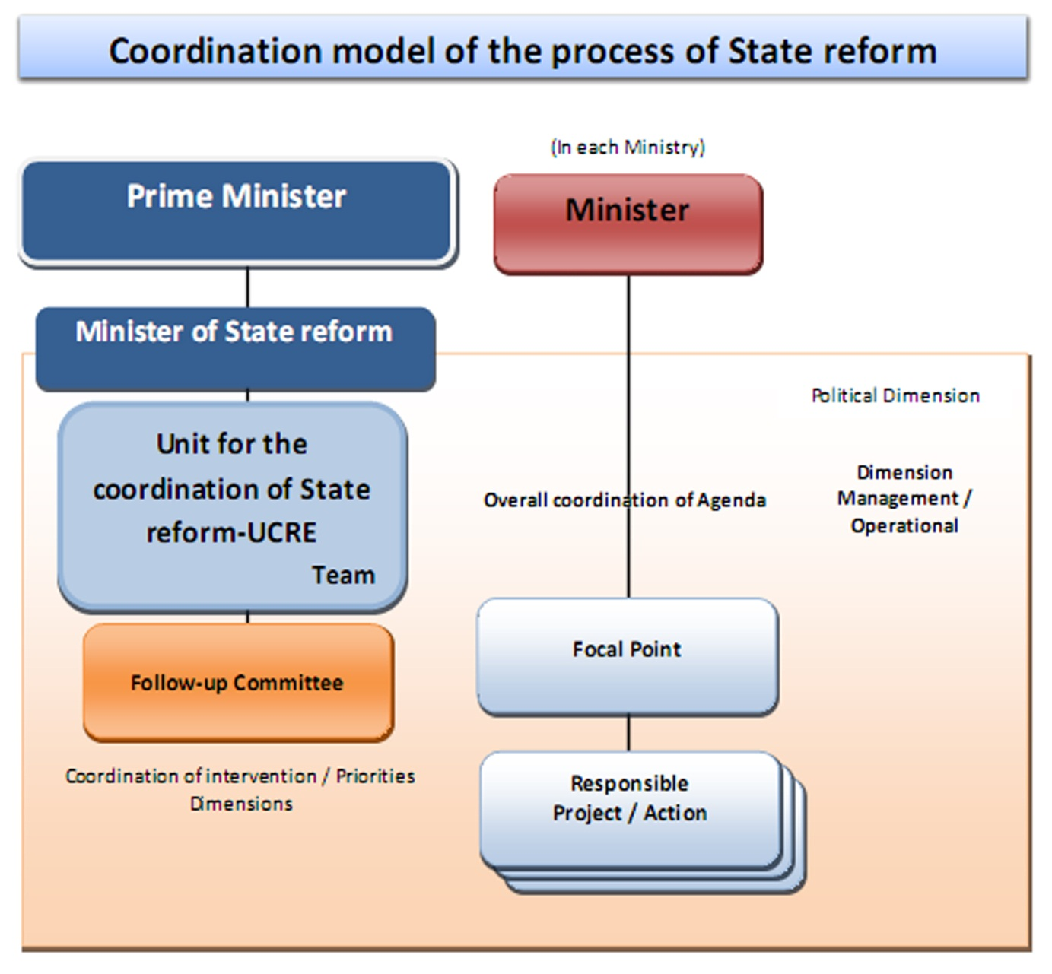
Modelo de Governança e Coordenação da Reforma do Estado
The coordination model of the process of reform of the State comprises two distinct levels of intervention: i) political intervention; ii) operational management intervention as illustrated below.

Slide 22
MAJOR OBJECTIVES OF THE GOVERNMENT PROGRAMME FOR THE MODERNIZATION OF PUBLIC ADMINISTRATION:
Make life easier for citizens and businesses.
Expansion of Electronic Governance at all levels of Government with particular attention to public services Forms.
Reducing bureaucracy and simplification of administrative procedures in all public services with particular relevance to finance, health services, education, Public Administration.
Training, qualification and Training Continues for human resources and improving working conditions.
Adopting modern criteria in the management of Human Resources
Containment of costs of public administration, both in terms of personnel expenses as goods and services.
Streamlining and improving the efficiency of public administration.
Appropriateness of Government economic growth objectives.
Establish efficiency and accuracy in organizational resources management in public administration.
Strengthen interdepartmental coordination between services and forms

Slide 23
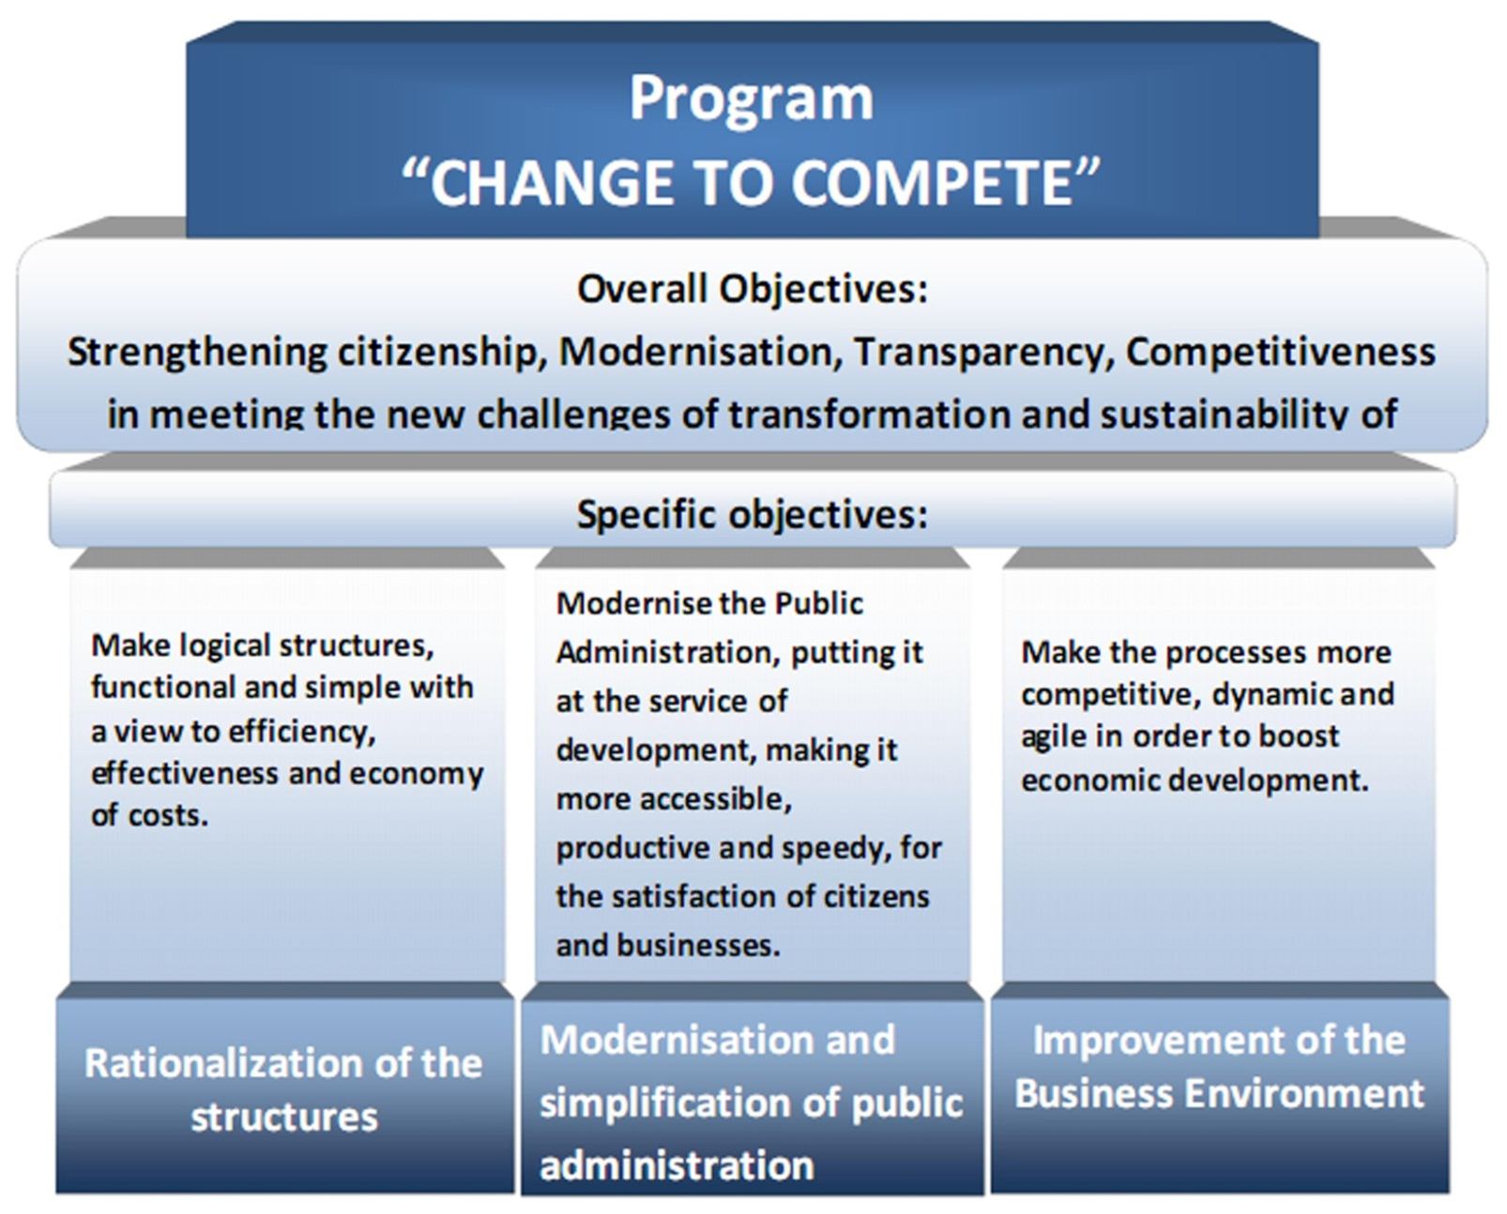
OBJECTIVES OF THE PROGRAMME “CHANGE TO COMPETE”
Notes:
23

Slide 24
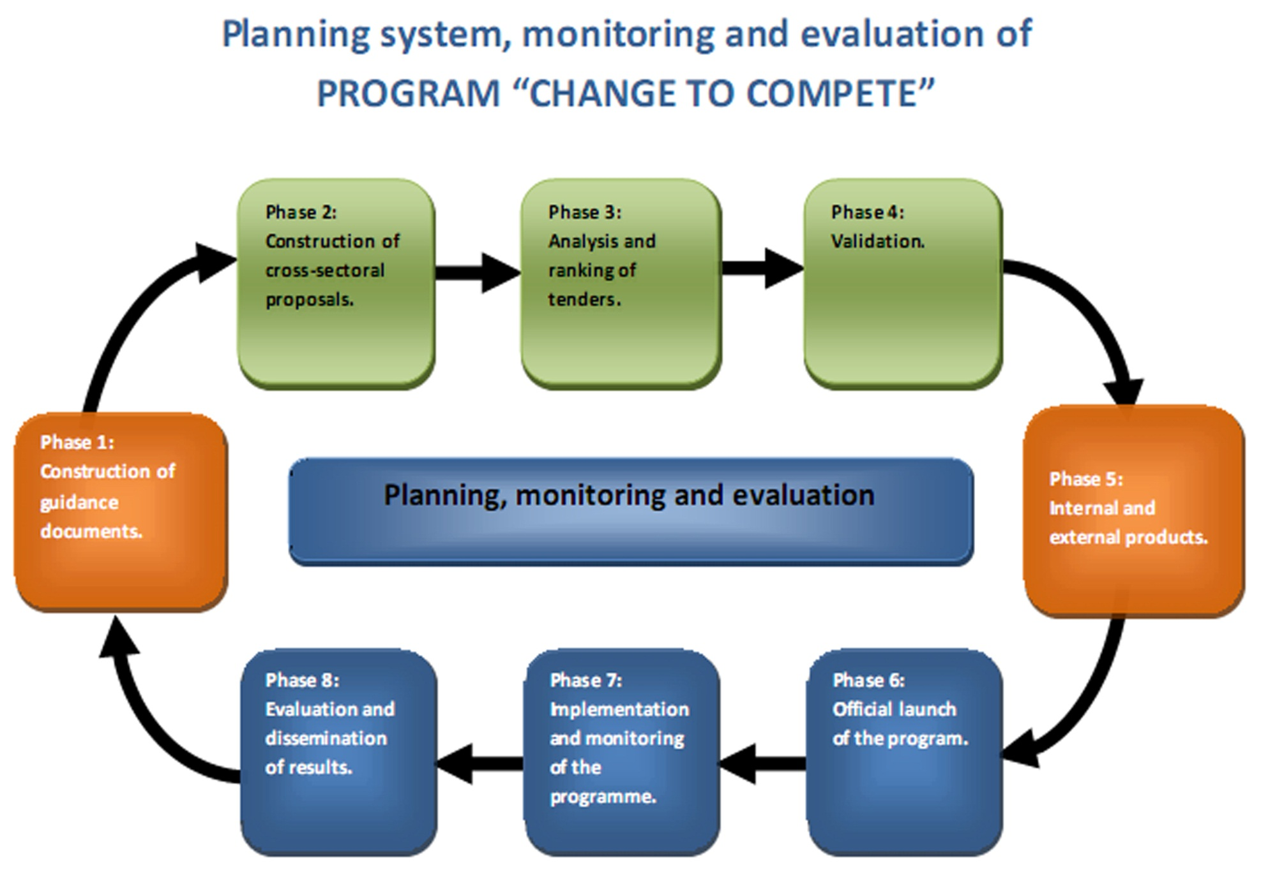

Slide 25
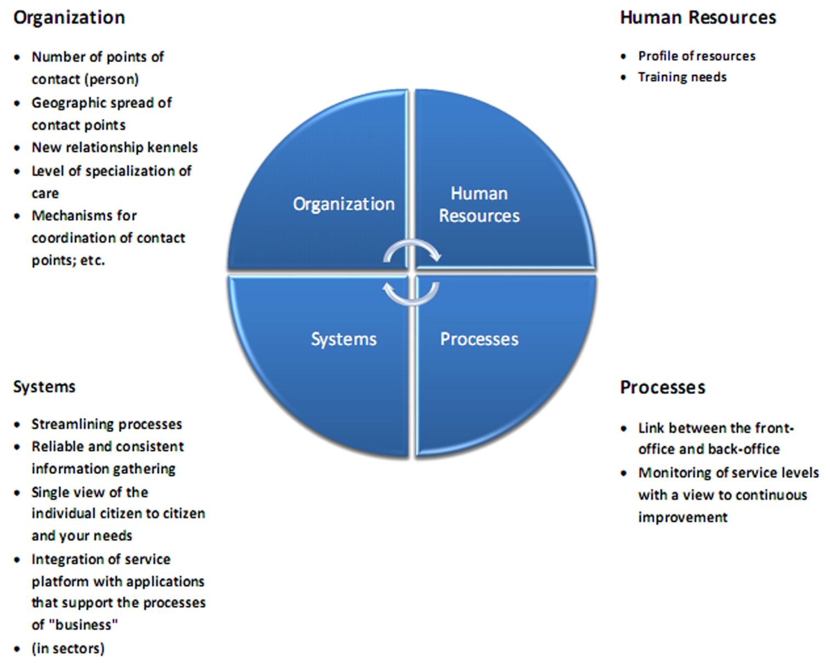
KEY ASPECTS OF OUR INTERVENTION AND NEW MANAGEMENT PRACTICES

Slide 26
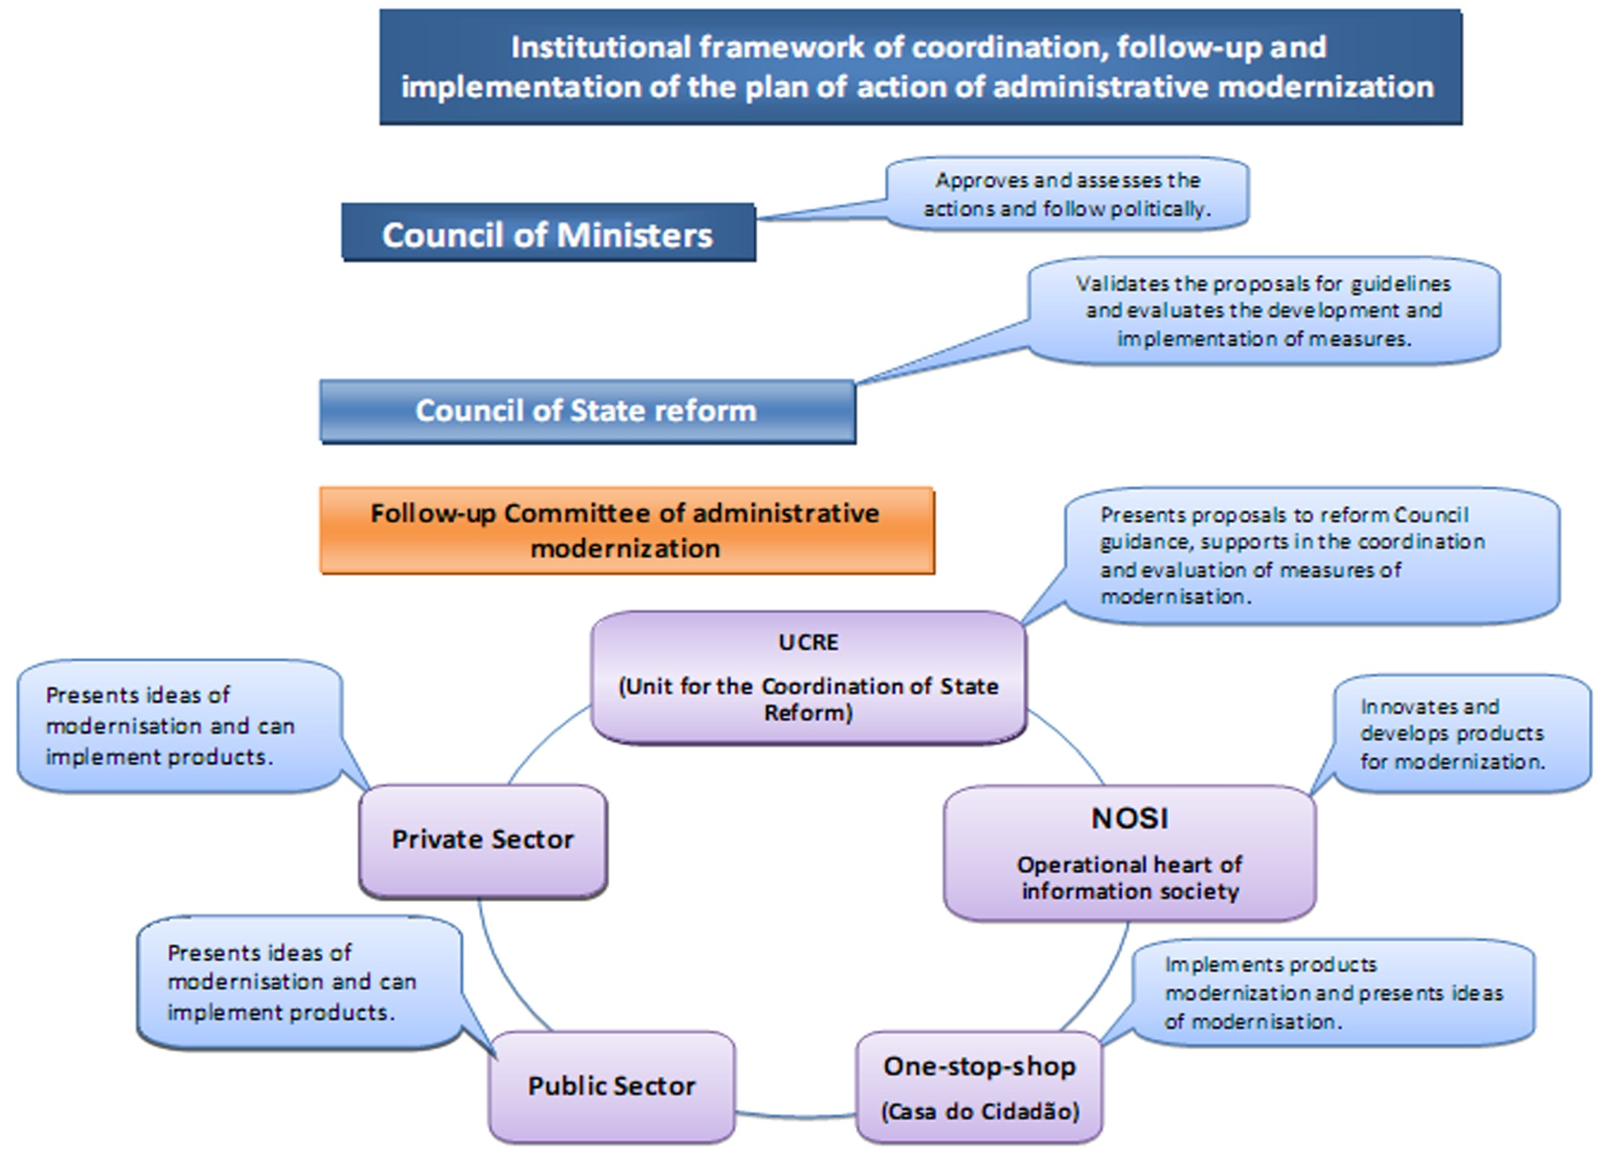
Notes:
Para enfrentar e coordenar todo esse desafio de melhoria de ambiente de negócios, o Governo estabeleceu uma task force junto da Unidade de Coordenação da Reforma do Estado, no sentido de encontrar formas de melhorar o desempenho de Cabo Verde nestas matérias, coordenar, seguir e avaliar a implementação do plano de melhoria de ambiente de negócios.
A task force fez a sua intervenção segundo duas perspectivas principais: trabalhando junto dos diversos sectores do Estado no sentido de melhorar a implementação das actuais políticas e práticas através de uma boa articulação, de acções coordenadas e também trabalhando junto das instituições que medem os indicadores de desempenho na implementação das políticas, procurando uma melhoria no que diz respeito na qualidade e a precisão dos dados.
26

Slide 27
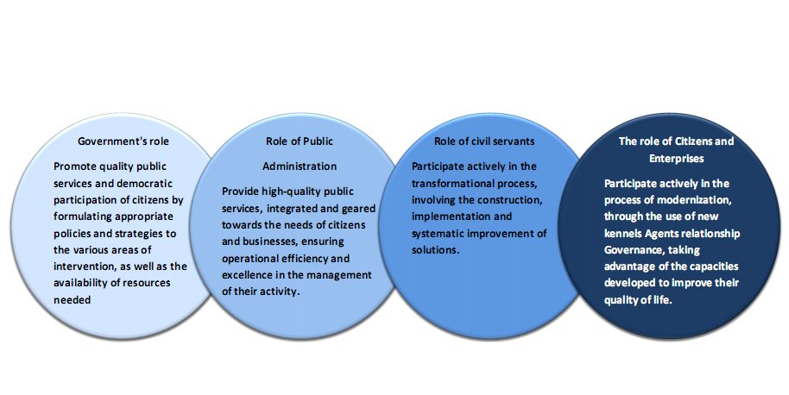
AND WITH THE INVOLVEMENT AND PARTICIPATION

Slide 28
PROCESS OF IMPLEMENTATION OF THE PROGRAMME OF “CHANGE TO COMPETE”
Requires strong changes to the level of articulation, coordination and evaluation:
Strong Technical and Policy coordination and linkage
Strong bet on inter-ministerial coordination and transversal
The collaboration should be the norm, since the development of ideas, planning, implementation, evaluation;
Ministries, autonomous agencies and institutions must stop working and planning in silos and work in a team and networking;
The relationship between the Government and Municipal authorities is crucial to the success of Agenda of transformation and modernization.
Liaison with the private sector and civil society is essential.
Focus on the needs of the citizen, businesses, market and society
The goals and the results should be specific and measurable.
Notes:
28

Slide 29
The Electronic Government Action Plan is focused on
six axis

Slide 30
IS MODEL FOR PUBLIC SERVICES
Services to Citizen
Decisions
Support Systems
www.portondinosilha.cv
Integration System
SIGOF –
BUDGET AND FISCAL
HUMAN
RESOURCES
ID
SYSTEM
OUTROS SISTEMAS
VERTICAIS
REGISTRY AND
NOTARY
APLICATION TO
HIGHER EDUCATION
ELEITORAL
SYSTEM
ELECTRONIC
PAYMENTS
DATADASES AND SERVER APLICATIONS
INFRASTURE AND COMUNICATION

Slide 31
Integrated Public Services
Eficient Public Administration
i-Services
e-Democracy
Electronic payments
Electronic Forms
Certificates online
Create a company in 60 min
Unique Car Document

Slide 32
PRINCIPAL ASSUMPTIONS
Citizen-centric: Services to focus on the needs of the citizens and maximise thier satisfaction.
One Stop Shop: Horizontal service delivery by the public administration agencies through the Citizens House to provide one front office for integrated products and services.
Orient by Live Events: The services and products are organized by groups around the life cycle needs of the citizens/companies. Not on how the Government is organized.
Quality: Strong emphasis on the quality of service delivery.
Notes:
Citizen Centric. Services centered on the citizens needs and satisfaction
One Stop Shop. The services in the House of Citizen are horizontal to all Departments of the Public Administration
With one front office for all the products (Department independent)
Live Events. The products are organized by groups that represent the life cycle of the citizen/company
Quality – Strong enphasis on quality of service

Slide 33
CURRENT MODEL
Creating a business?
Multiple Front offices
Repetition of forms
Lack of consistency
Multiple Efforts
Waste of time
Public Services
Registry
TAX
Municipality
Commerce
Industry
Tourism

Slide 34
New Model
Multiple Front offices
Repetition of forms
Lack of consistency
Multiple Efforts
Waste of time
Public
services
SA
Registry
B
R
O
K
E
R
TAX
Municipality
w w w
SS
Commerce
Industry
SA
Tourism

Slide 35
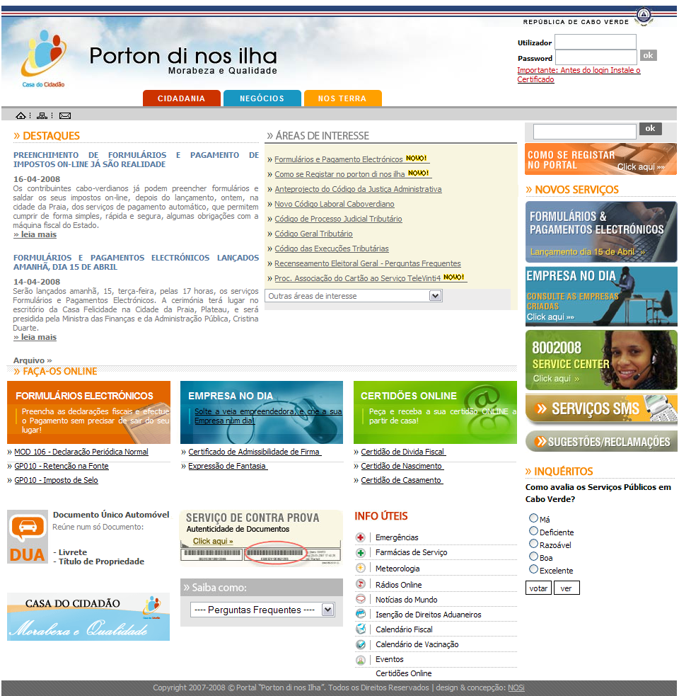
Public Services Portal
Government Portal

Slide 36
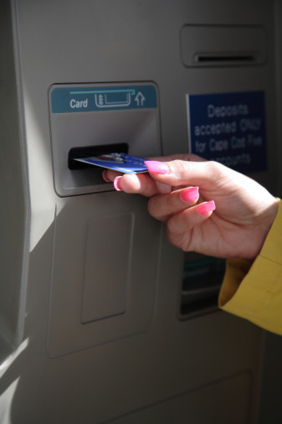
INTEGRATED PUBLIC SERVICES
What is it?
Ability to pay for public services electronically, using the tools already available in Cabo Verde, namingly debit (Vinti4) and credit cards, ATM machines and the INTERNET using the portal www.portondinosilha.cv
Electronic payments
Objectivs
Diversify payment options for services offered by the Public Administration
Allow Internet Transactions
Facilitate access to services offered by Government Departments through their front offices
Benefits & Impacts
Ease of access by citizens
Quick services
Payment security
Increase revenues
Increase transparency
Notes:
Ability to pay for public services electronically , using the tools already available
in Cabo Verde, namingly debit (Vinti4) and credit cards, ATM machines
And the INTERNET using the portal www.portondinosilha.cv

Slide 37

INTEGRATED PUBLIC SERVICES
What is it?
Ability to complete all government forms online by citizens and firms, e.g. fiscal forms
Forms can be completed online or offline
Electronic Forms
Objectivs
Improve the relationship between citizens and public administration
Quick delivery of services
Benefits & Impacts
Efficient delivery of services
Improved productivity and back office operations
Less possibility of errors
Increase capacity to manage
Notes:
Ability to fill electronically forms that support the relationship between
The Public Administration and the society with special focus on the fiscal area
Online and offline forms

Slide 38

INTEGRATED PUBLIC SERVICES
What is it ?
Delivery of documents including certificates online with the same level of security and authenticity as traditional paper documents
System to ensure strong athentication mechanism
Certificates online
Objectives
Paperless service delivery
Avoid the delivery of certificates between Government entities or agencies
Immediate delivery of documents combined with automatic updates, over a predetermined period
Benefits & Impacts
Speed – Any front office with the rights can print any online document notwisthstanding location
Secutrity – A tool will be available to verify authenticity based on document codes
Notes:
The delivery of documents (ex. certificate) by the public administration
In electronic format with the some level of accountability as the traditional paper format
And with strong authentication mechanism

Slide 39
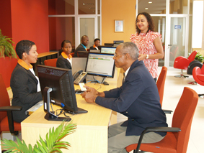
INTEGRATED PUBLIC SERVICES
What is it ?
A public facility that allows for the creation or setup of businesses such as limited liability compnanies in one hour from unique front offices which are close to potential clients
Create a firm
in 60 minutes
Objectives
Merge all related processes and databases in a unique integrated information system
Simplify and integrate the processes and diverse services needed to create companies
Promote investment in Cabo Verde
Facilitate the competitiveness of Cabo Verde
Benefits & Impacts
Adoption of standard rules;
Create firms without public registration when partners do not have buildings as part of the social capital;
Automatic assigning of NIF and immediate registration by DGCI;
Immediate publication on the official site of the National Printing Office
Notes:
A new public service wich provides the possibility to start a business in 60 minutes.
the entrepeneur only interacts with one front office, avoiding the need for multiple
Efforts and redundancy

Slide 40
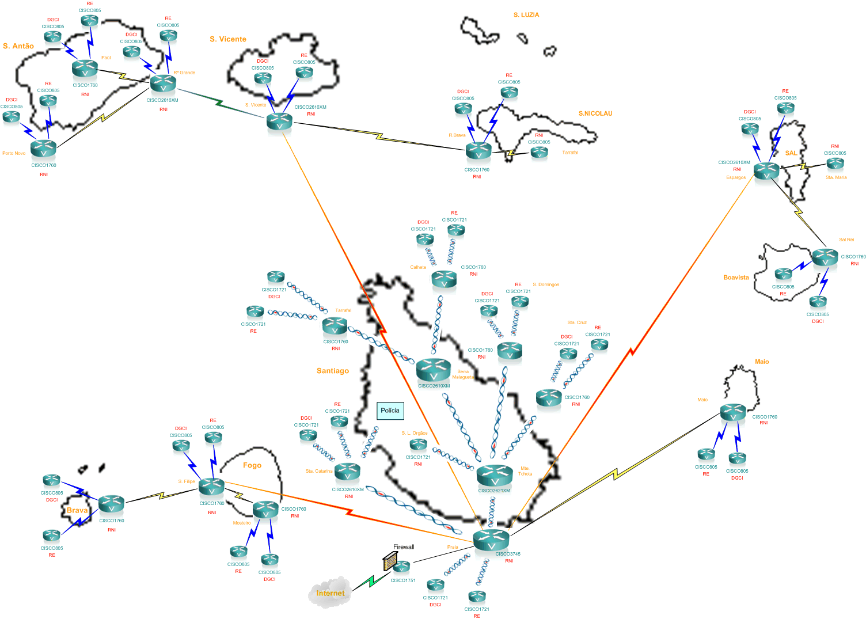
STATE NETWORK
8.000 Computers 20.000 Public servants
On-Line
Presidency
Parliament
Courts
Ministries
Institutes
Some Municipalities
10.000
Computers
by 2012

Slide 41
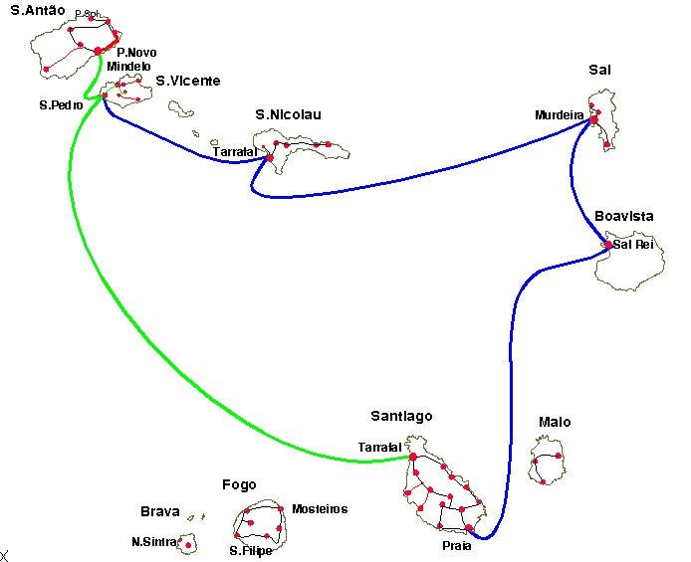
Fiber optic infrastructure

Slide 42
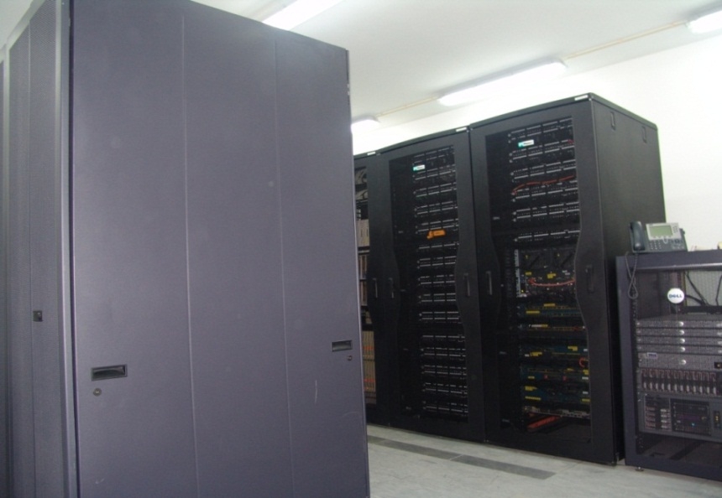
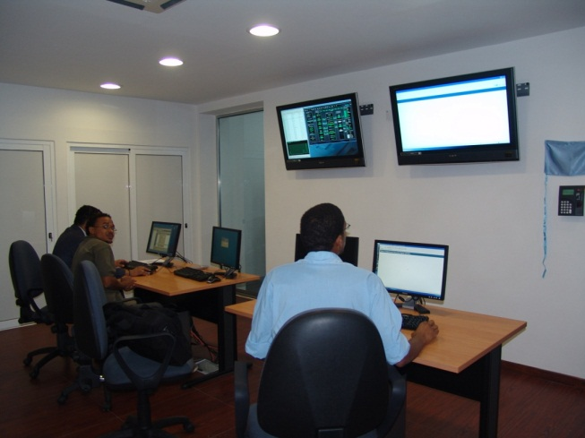
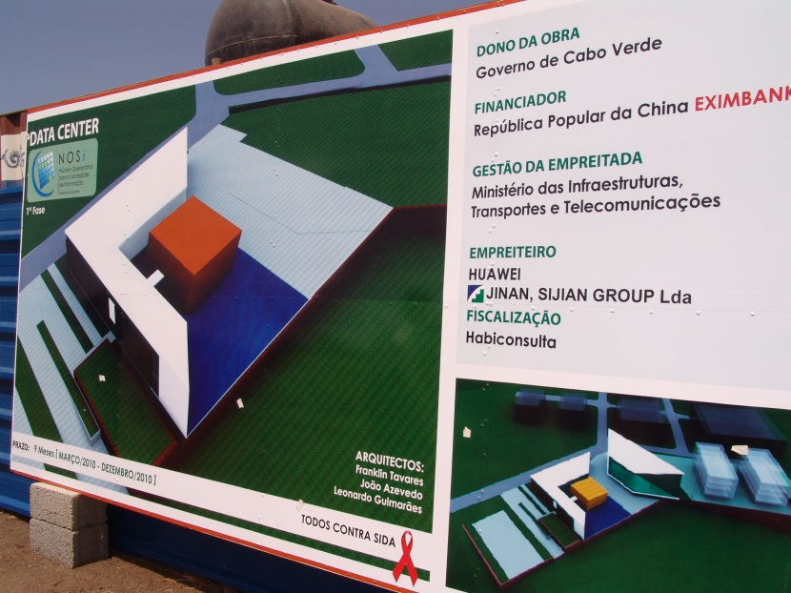
Contents-Security
Networks provide great convenience to us. Nevertheless, because the TCP/IP protocols for the Internet lack security, network security becomes an unavoidable problem.
With the increasing popularity of network application, especially in some sensitive scenarios (electronic commerce, for example), the demand for network security becomes more and more pressing.
Network security is a complicated subject. It includes each layer of network communication, and relates to many fields like host system security, line security, protocol security, communication security, and so on.
(new data center under construction)

Slide 43

MOTTO
"THINKING TO BE ABLE TO ACT AND ACT IN ORDER TO THINK."
"THINKING WITH OUR OWN HEADS"
AMILCAR CABRAL

Slide 44
THANK YOU for YOUR ATTENTION and participation
Consult the site State reform in Cape Verde:
www.reformadoestado.gov.cv
State reform unit

